Slide 1
Module 2:
You are a developer and need to test the latest version of your code. You are going to a deploy sandbox using the promotion manager blueprint.

Slide 2
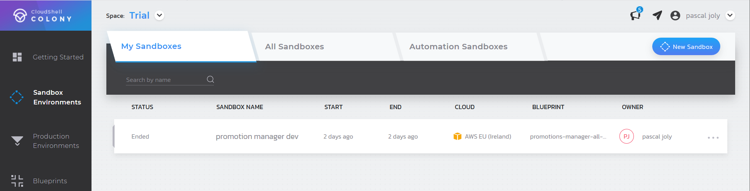
Launch a new sandbox

Slide 3
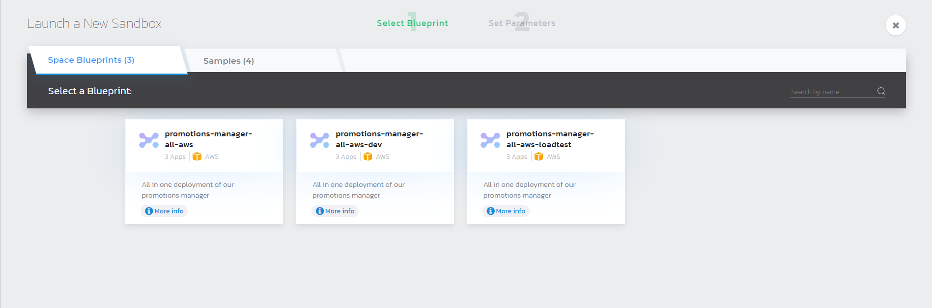
Select the dev blueprint

Slide 4
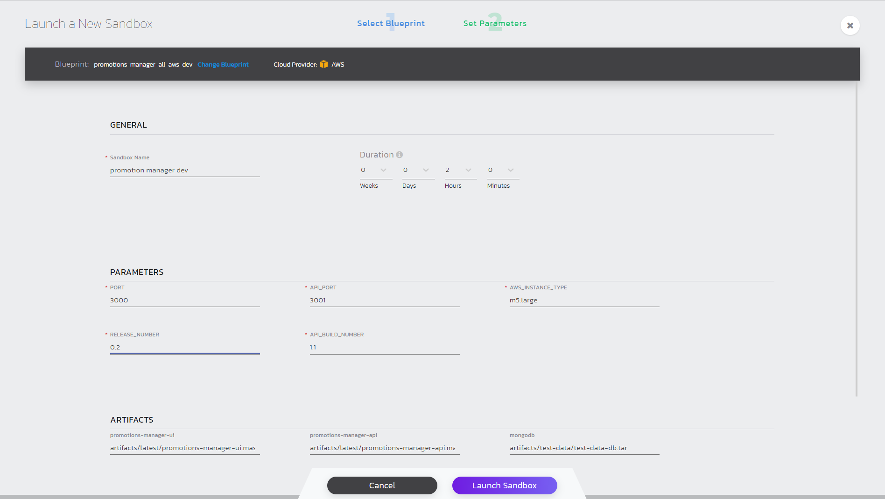
Fill in parameters and duration
Provide a name for your sandbox. Update release number and build number

Slide 5
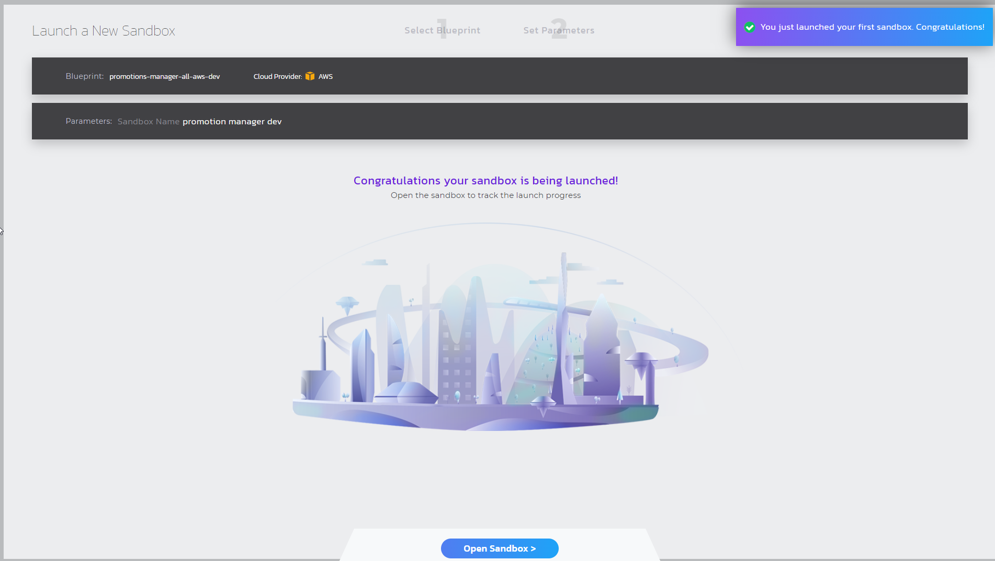
Launch sandbox

Slide 6
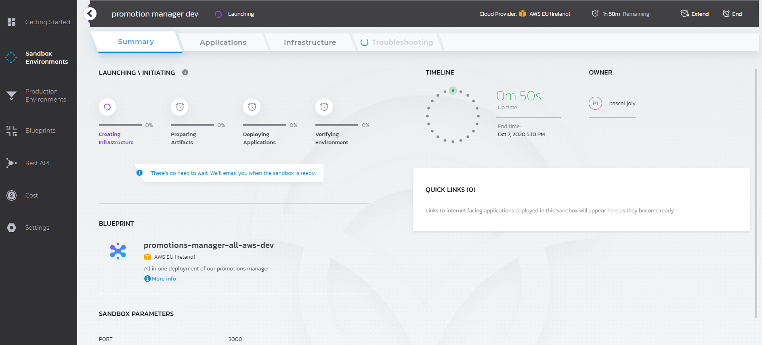
Open the sandbox

Slide 7
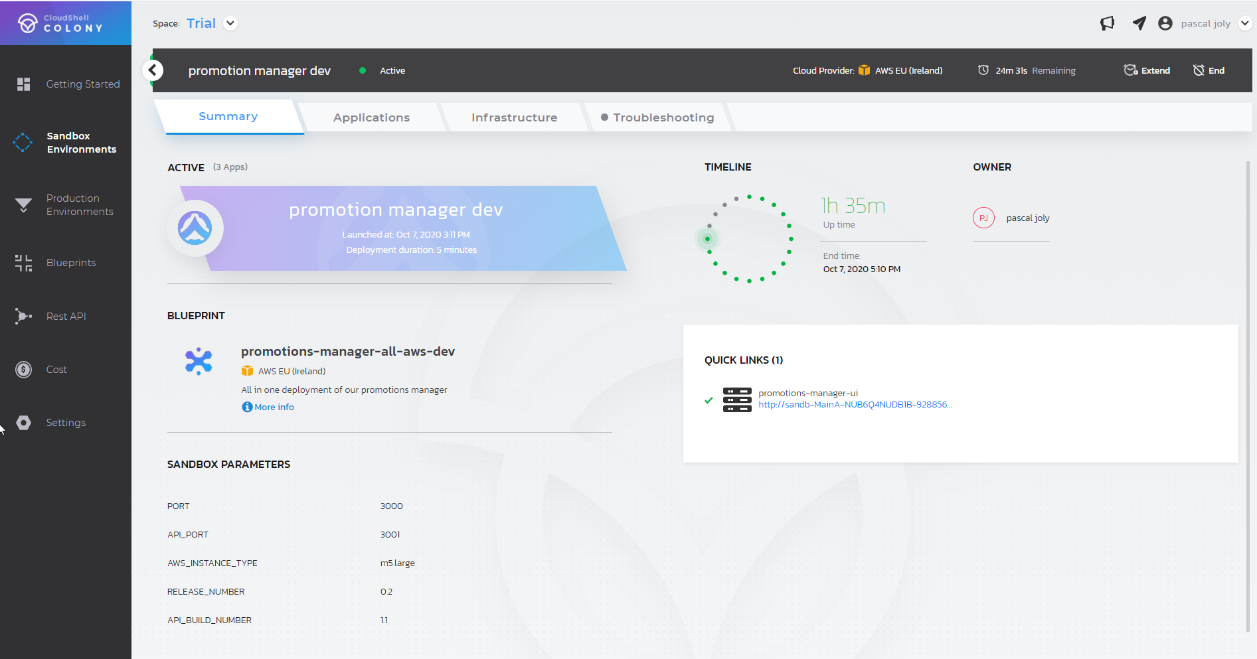
Access promotion manager with quick link

Slide 8
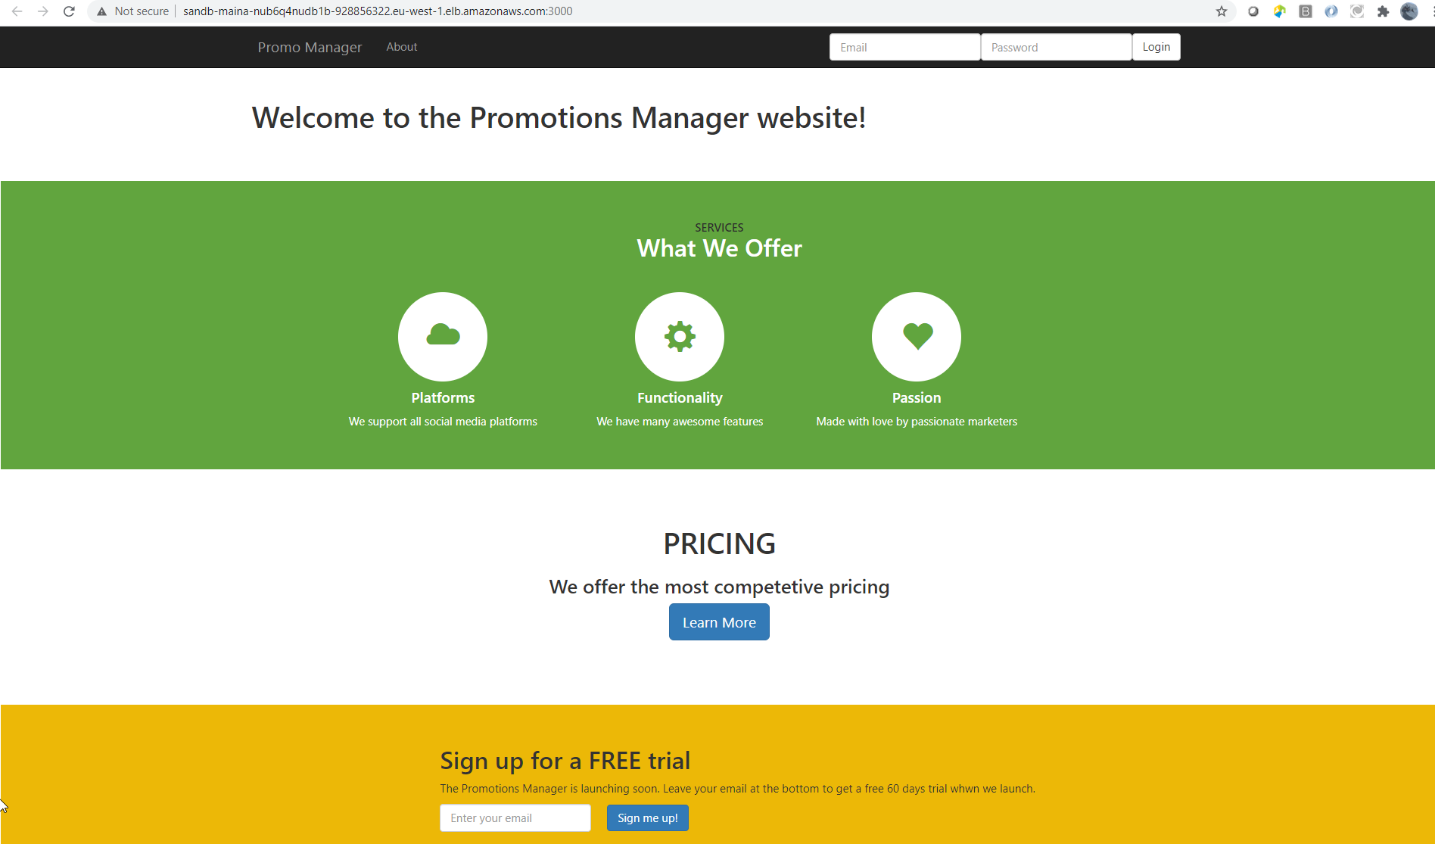
Gourmet Inc

Slide 9
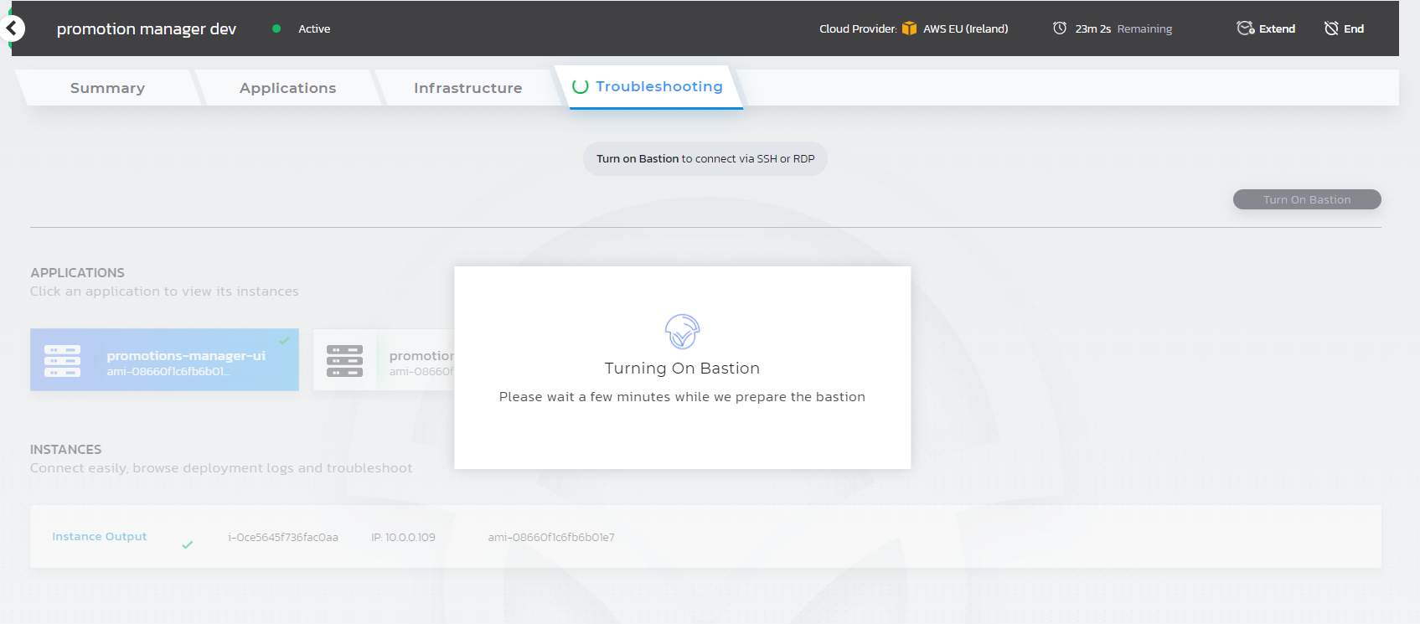
Troubleshoot instances: turn on bastion
Notes:
Turning on/off bastion
Isolation of the instance ootb

Slide 10
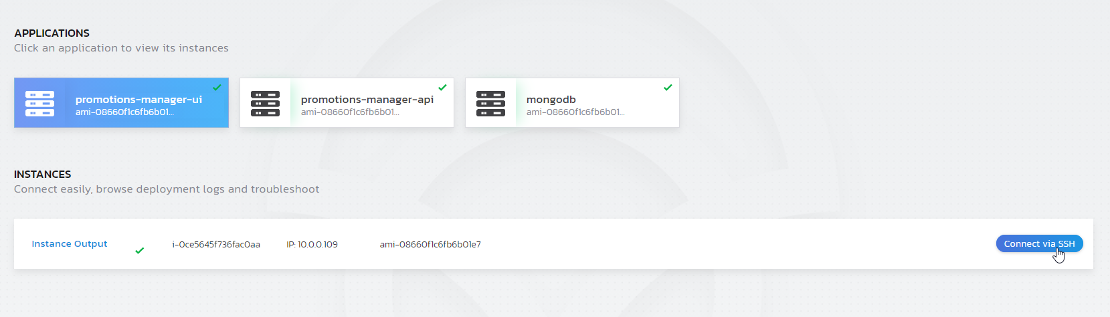
Access VM host console

Slide 11
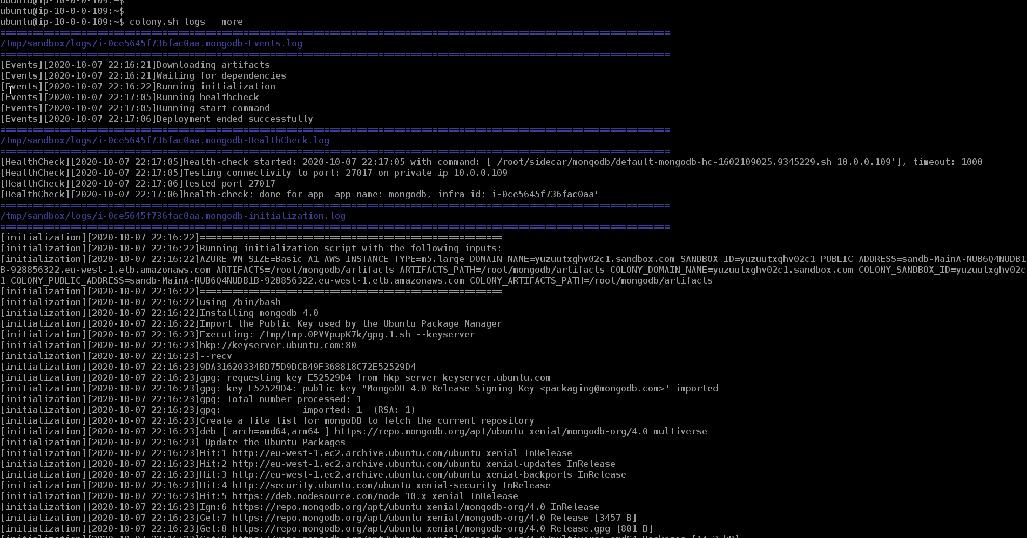
check out the logs: run colony.sh logs
Notes:
Run command to see the deployment logs colony.sh logs

Slide 12
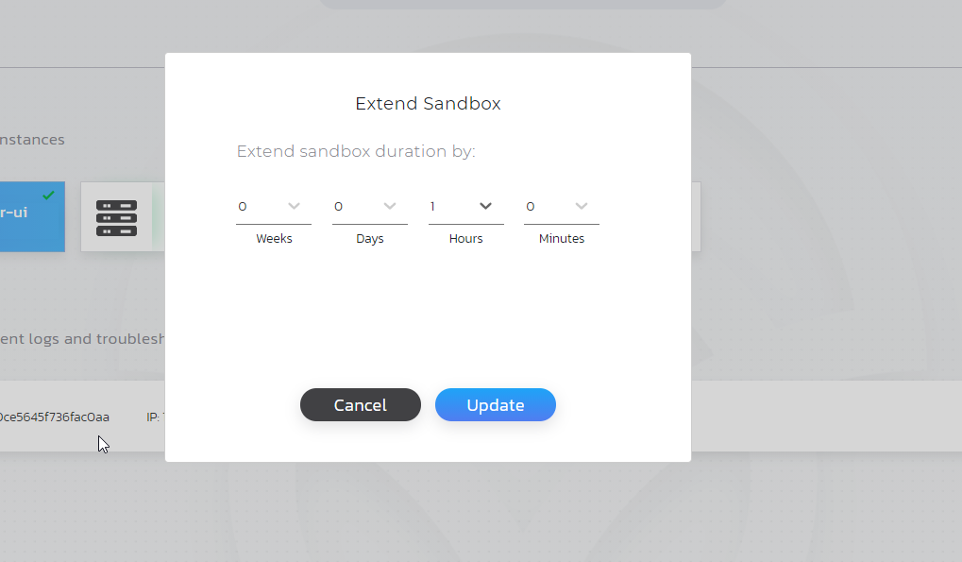
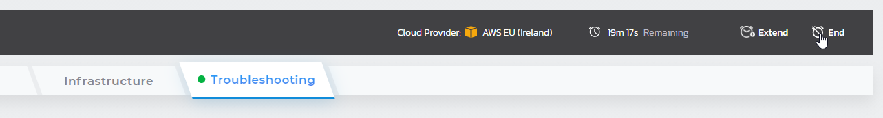
Automated Decommissioning vs. extend
Before the sandbox expires extend the default time from 2 hrs to 3hrs.
By default, it will be automatically decommissioned once the specified time has expired, or you can end the sandbox from the UI
Notes:
“Always down” architecture/contract.

